Slide 1
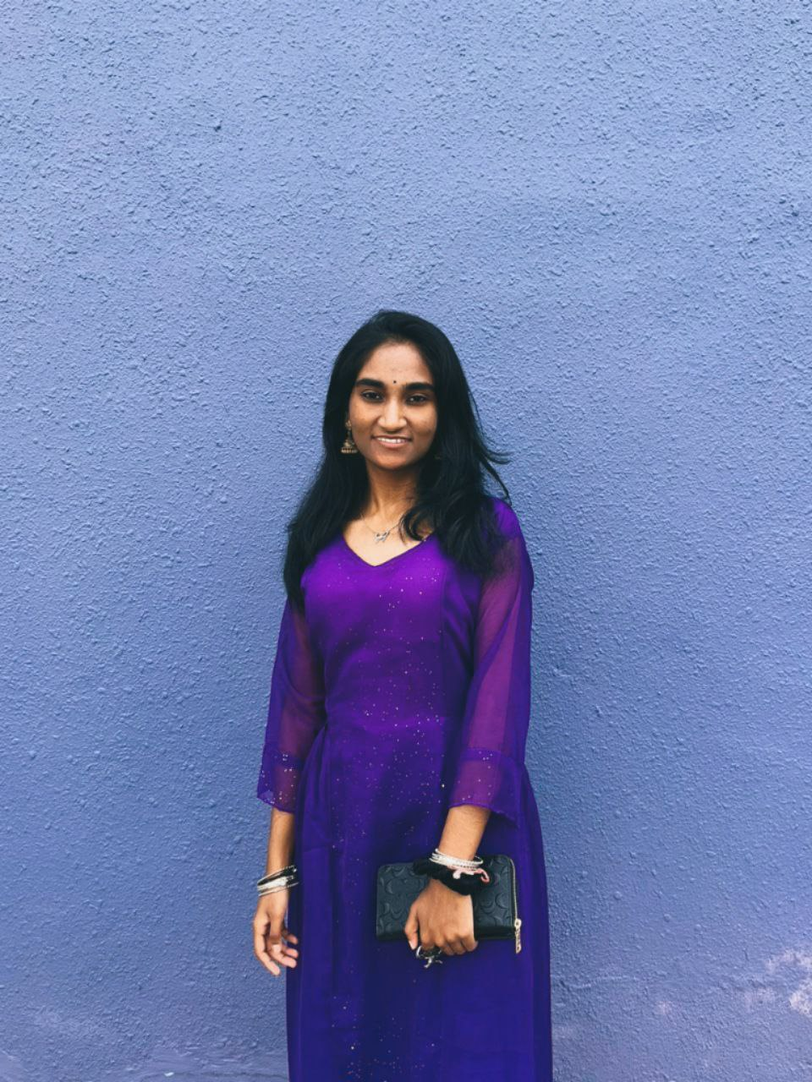
Good morning to my fellow Evaluator and
Supervisor.
I’m ROSHINI RAMES from 2 BITI S1G2
Matric ID B032110385

Slide 2
WORKSHOP 1
RH CYBERCAFE MANAGEMENT SYSTEM
NAME : ROSHINI RAMES
SECTION : 2 BITI S1G2
MATRIC : B032110385
SUPERVISOR : DR.HALIZAH BINTI BASIRON
EVALUATOR : PROF.DR. AZAH KAMILAH BINTI DRAMAN

Slide 3
AGENDA
1. Background
2. Problem statement
3. Objectives
4. Project Scope
5. E.R.D
6. Calculations
7. Conclusion
3

Slide 4

PROJECT INTRODUCTION

Slide 5
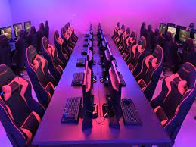
BACKGROUND
Manages cybercafe device bookings inclusive of 20 devices
Cybercafe operates from 09.00 a.m to 10.00p.m
Three membership options are available to be registered by members.
Per device booking costs according to the duration of device usage and the membership discounts
Members have discounts of prices varying based on their membership plans

Slide 6
PROBLEM STATEMENT
TIME-CONSUMING AND INEFFICIENT BOOKING SERVICE
MANUAL REPORTING OF SALES OF BOOKING
HARD TO KEEP TRACK OF THE DEVICE
AVAILABILITY
6

Slide 7

OBJECTIVES
To identify the requirements for the cybercafe management system.
To design the processes involved in the system and analyze the requirements of the system.
To develop the RH Cybercafe Management System using SQL and C++ based on the requirements
7

Slide 8
USERS SCOPE
01
02
03
ADMIN
STAFF
MEMBER
8

Slide 9
SYSTEM SCOPE
06
USER MANAGEMENT MODULE
01
LOGIN MODULE
07
DEVICE ENTRY MODULE
02
REGISTER MODULE
08
DEVICE MAINTENANCE MODULE
03
FORGOT PASSWORD MODULE
09
REPORT MODULE
04
BOOKING MODULE
10
MEMBERSHIP RENEWAL MODULE
05
PAYMENT MODULE
9

Slide 10
ENTITY
RELATIONSHIP
DIAGRAM

Slide 11
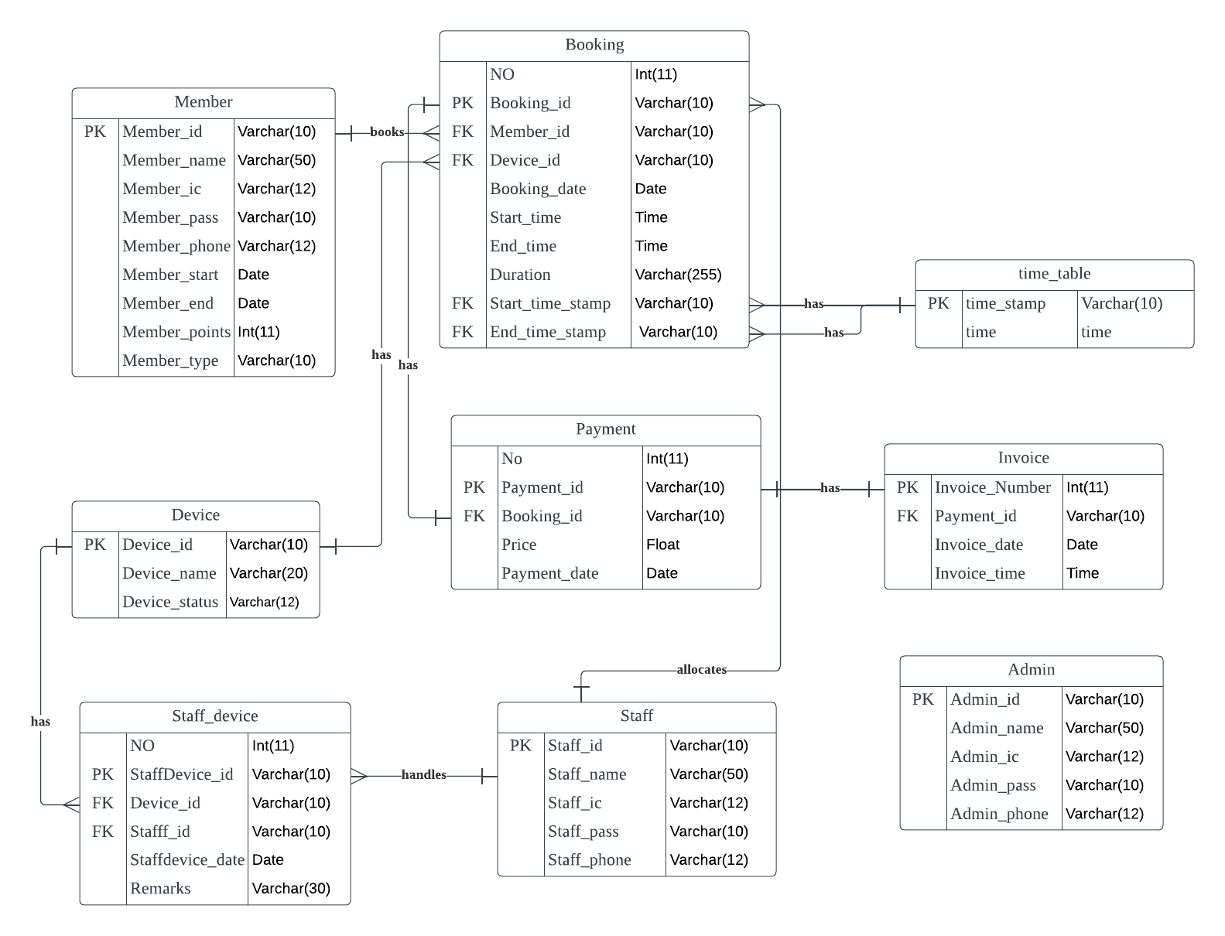
11

Slide 12
CALCULATIONS

Slide 13
OPERATIONS:-
01 Points and Rewards Redemption
Membership plans | Discounts and Rewards
Student Membership plan | Discount = 15% Reward = 20 points
Basic Membership plan | Discount = 20% Reward = 20 points
Premium Membership plan | Discount = 30% Reward = 40 points
DIVISION
MULTIPLICATION
ADDITION
SUBTRACTION
13

Slide 14
CONCLUSION
RH Cybercafe Management System (RHCMS) has been developed with the conjunction of SQL and C++.
RH Cybercafe Management System has been developed where for an efficient and less time-consuming booking with various types of payment methods.
RHCMS can be upgraded with a graphical user interface (GUI).
RHCMS can be improved by optimizing the database performance through enhancing data integrity.
RHCMS can be updated to be used by the non-members to have a booking session as a guest.
14

Slide 15
SYSTEM DEMONSTRATION
15

